Slide 1
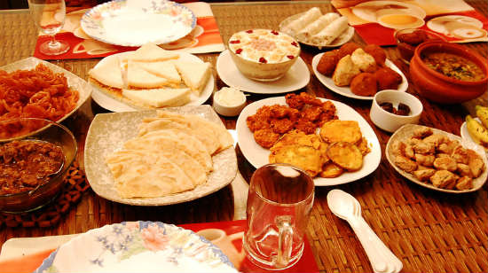
Food Ordering Application

Slide 2
Peoples who can place order
Hotel guests from the Hotel rooms.
Hotel guest at restaurant.
Outside guest at restaurant.

Slide 3
Hotel guests from the Hotel rooms

Slide 4

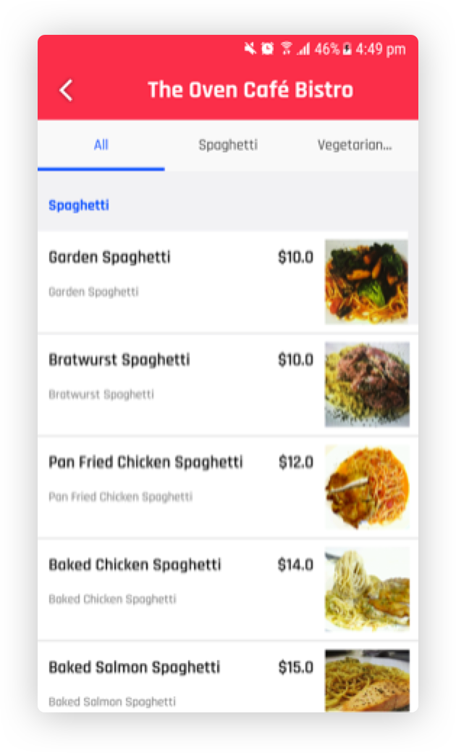
Hotel guests from the Hotel rooms
One Time Login
MENU
LOGIN
Enter Room Number
Menu to order Food
304
-OR-
Enter Staff ID
blank
SUBMIT
Place Order

Slide 5
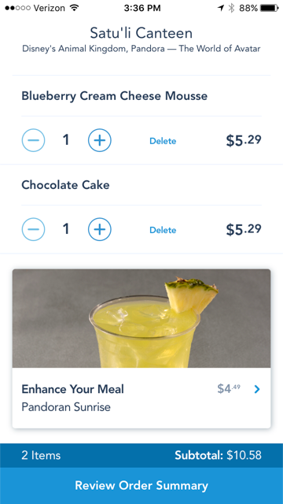
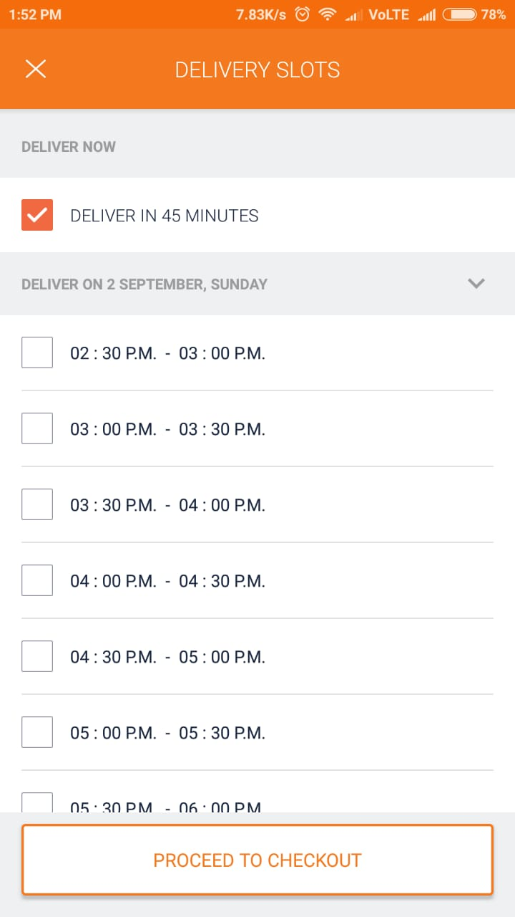
Hotel guests from the Hotel rooms
Order Details before placing the order
Order Preview
Deliver Later
If want to place order for future
Deliver Later
Deliver Now
Submit

Slide 6
Hotel guests from the Hotel rooms
Order Preview
Order placed
Order placed successfully
OK
Deliver Later
Deliver Now

Slide 7
Hotel guest/ Other guest at restaurant.

Slide 8
Hotel guest at restaurant.
MENU
LOGIN
Enter Room Number
blank
-OR-
Enter Staff ID
ABC123
SUBMIT
Place Order

Slide 9
Hotel guest at restaurant.
This option will prompt in restaurants not in Hotel rooms
MENU
Order Preview
Enter you room No.
302
-OR-
TAKE AWAY
OK
Place Order
Deliver Now

Slide 10
Hotel guest at restaurant.
Order Preview
Order placed successfully
OK
Deliver Now

Slide 11
Admin panel

Slide 12

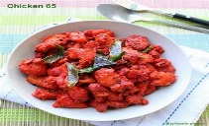
Admin Panel
To add new items in the list
Add new Item
List of items already available
Sl. No | Name | Price | Image | Description | Category | Veg/Non-veg | Option
1 | Chicken 65 | 250 |  | Abcdehjfdj | Indian | Nonveg
2 | Paneer tikka | 200 |  | Abcdehjfdj | Indian | Veg
Edit
Delete
Edit
Delete

Slide 13

Admin Panel
On Add item, this popup allows to add new item
Add new Item
Sl. No | Name | Price | Image | Description | Category | Veg/Non-veg | Option
1 | Chicken 65 | 250 |  | Abcdehjfdj | Indian | Nonveg
2 | Paneer tikka | 200 |  | Abcdehjfdj | Indian | Veg
Name | Price | Image | Description | Category | Veg/ Non-Veg
Enter name | Enter Price | Upload Image | Enter Description | Select Category | Select type
Edit
Delete
Edit
Delete
save

Slide 14
Order Received Screen
All orders can be viewed here
Order Received
01. Room: 308 Received: 2nd sept. 4:00PM Delivery Time : Now
Chicken Tikka: 1qty
Mutton Biryani: 1qty
02. Room: 206 Received: 2nd sept. 6:30PM Delivery Time : 10.00PM
03. Room: 411 Received: 2nd sept. 8:00PM Delivery Time : 9.30PM
Expand to see the full details

Slide 15
Thank You

